Slide 1

Supervisor Assessment
João Henrique Linhares

Slide 2
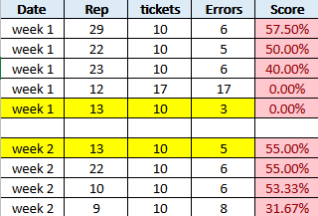
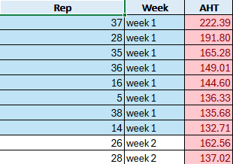
Quality

Slide 3
Personnel
Measurement
Motivation
Few Calibrations
Knowledge of the Policy
Lack of Attention
Low Accuracy and High AHT
Noisy Ambient
Tooling Issue
Work-Station Position
Lack of Documents about the Policy
Environment
Material
Figure: The Ishikawa diagram for AHT and Accuracy pointing the possible causes of low accuracy and high AHT

Slide 4
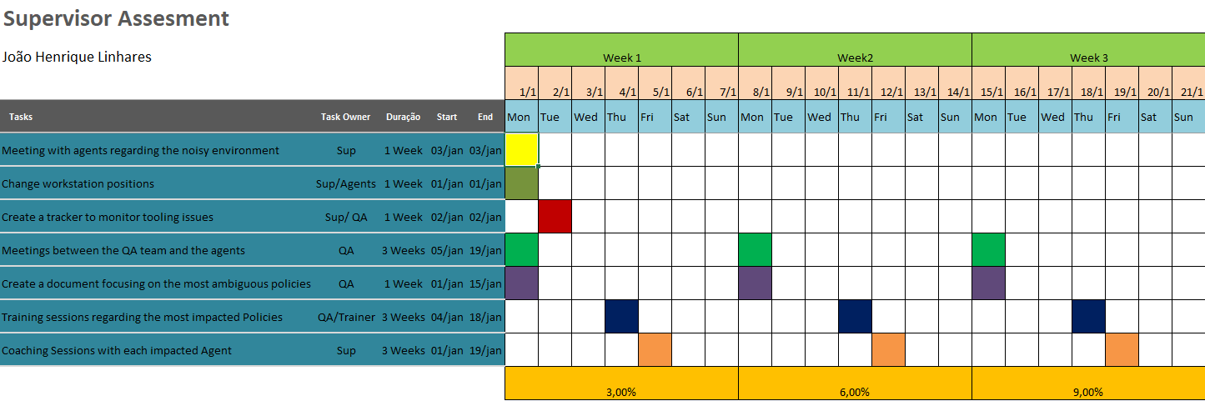
Based on the Ishikawa diagram, I produced this action Plan

Slide 5

Absenteeism Action Plan
Team A
Have an individual meeting with the ones without medical leave and give an Action Form
Offer the agent the option of taking unpaid leave to support their family during a difficult time.
Recommend utilizing company resources, such as psychological assistance.

Slide 6

Absenteeism Action Plan
Team B
Conduct a meeting with all agents to explain the impact of their absences
Motivate the Team: Promotion opportunities, work with experience team etc…
Adjust the agent's work schedule to fit their study hours

Slide 7

Adherence
Action Plan
Have a meeting reinforcing that it’s not permissible to take breaks and lunch simultaneously
Give a said expectations for all the agents out WFM alignment
Work with WFM to adjust break and lunch schedules to fit agents' needs.
Tell agents to use auxiliary time for bathroom breaks or other personal needs.

